Slide 1
Tree-based Multilevel Models
Treatment Selection Idea Lab 2018 Marjolein Fokkema

Slide 2

Contents
Introduction to trees
Trees vs. linear models
R ex. #1: Predicting depression using personality scales
Trees for multilevel and longitudinal data (mixed-effects trees)
R ex. #2: Predicting treatment outcomes in a multi-center dataset
R ex. #3: Detecting treatment-subgroup interactions in a multi-center dataset

Slide 3
Assumed skills and knowledge
Some knowledge about and skill in fitting and interpreting generalized linear mixed-effects models (GLMs and GLMMs)
Some experience with fitting these models in R
Slides, datasets and code with guidance digitally available at ………
Copy and execute code yourself, from file ‘Fitting_mixed-effects_trees_in_R.pdf’
Feel free to tweak, tune, adjust and comment

Slide 4
Advantages of tree methods
Data-analytic flexibility
Predictor variables may be categorical, ordinal or continuous
No (or very few) assumptions about data distribution
E.g., no assumptions of linearity or additivity; interactions and non-linear effects automatically accomodated
Can deal with many potential predictors (p > N no problem)
Easy to interpret and apply
Direct identification of subgroups
Easy to use in decision making (no formulas, no computation)
Not all variables in model need be assessed for making decision

Slide 5
Disadvantage of tree methods
Instability: Small changes in data may yield very different tree
But:
Traditional (generalized) linear models are also unstable, changing tree structure just looks much worse than changing coefficients in linear model
Just as with (generalized) linear models, mixed-effects trees are more stable and accurate
For state-of-the-art predictive accuracy, use tree ensembles, but they provide suboptimal interpretability
Prediction rule ensembles strike balance between accuracy and interpretability. See R package pre (Fokkema & Christoffersen, 2018).

Slide 6
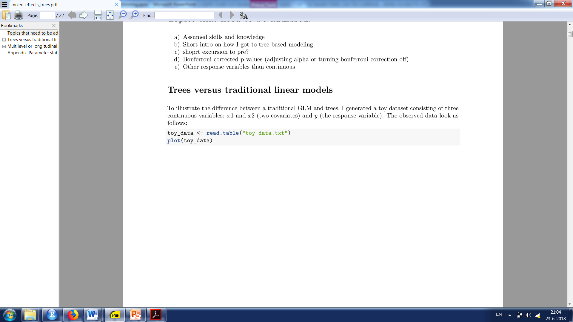
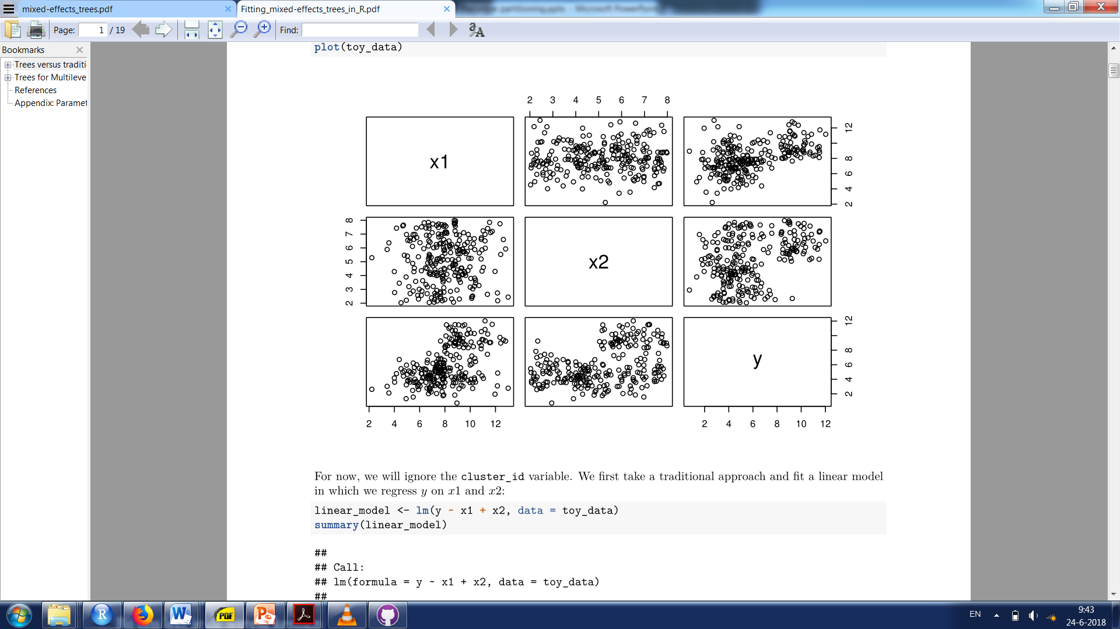
Traditional (generalized) linear model vs. trees

Slide 7
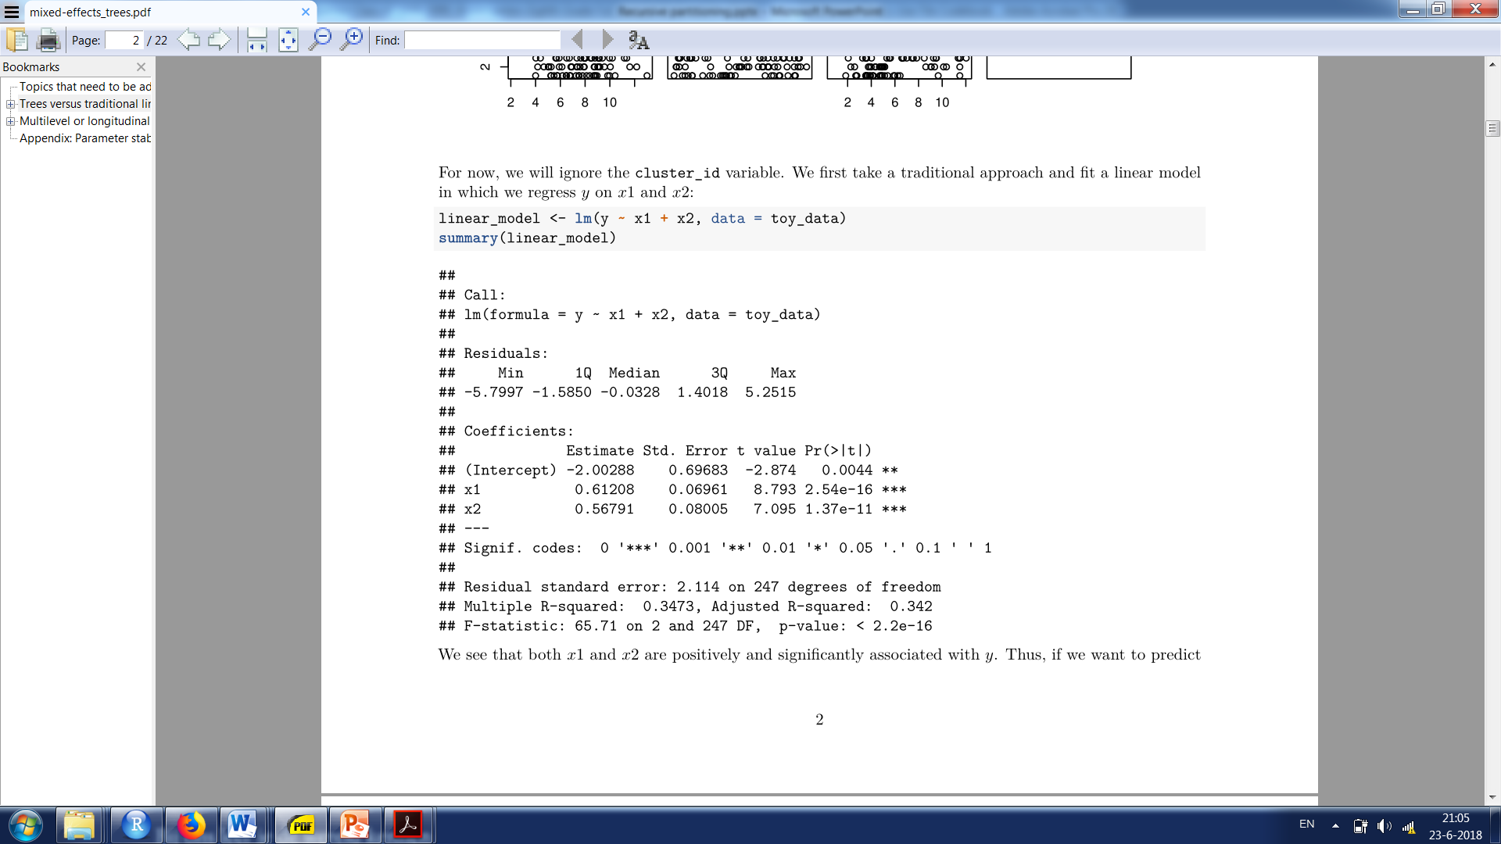
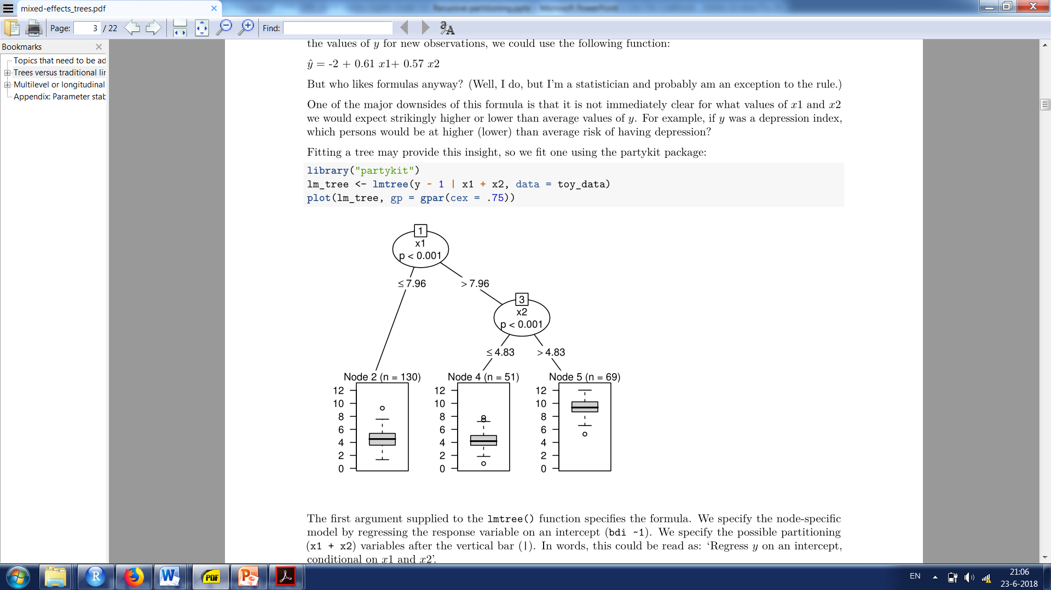

Slide 9
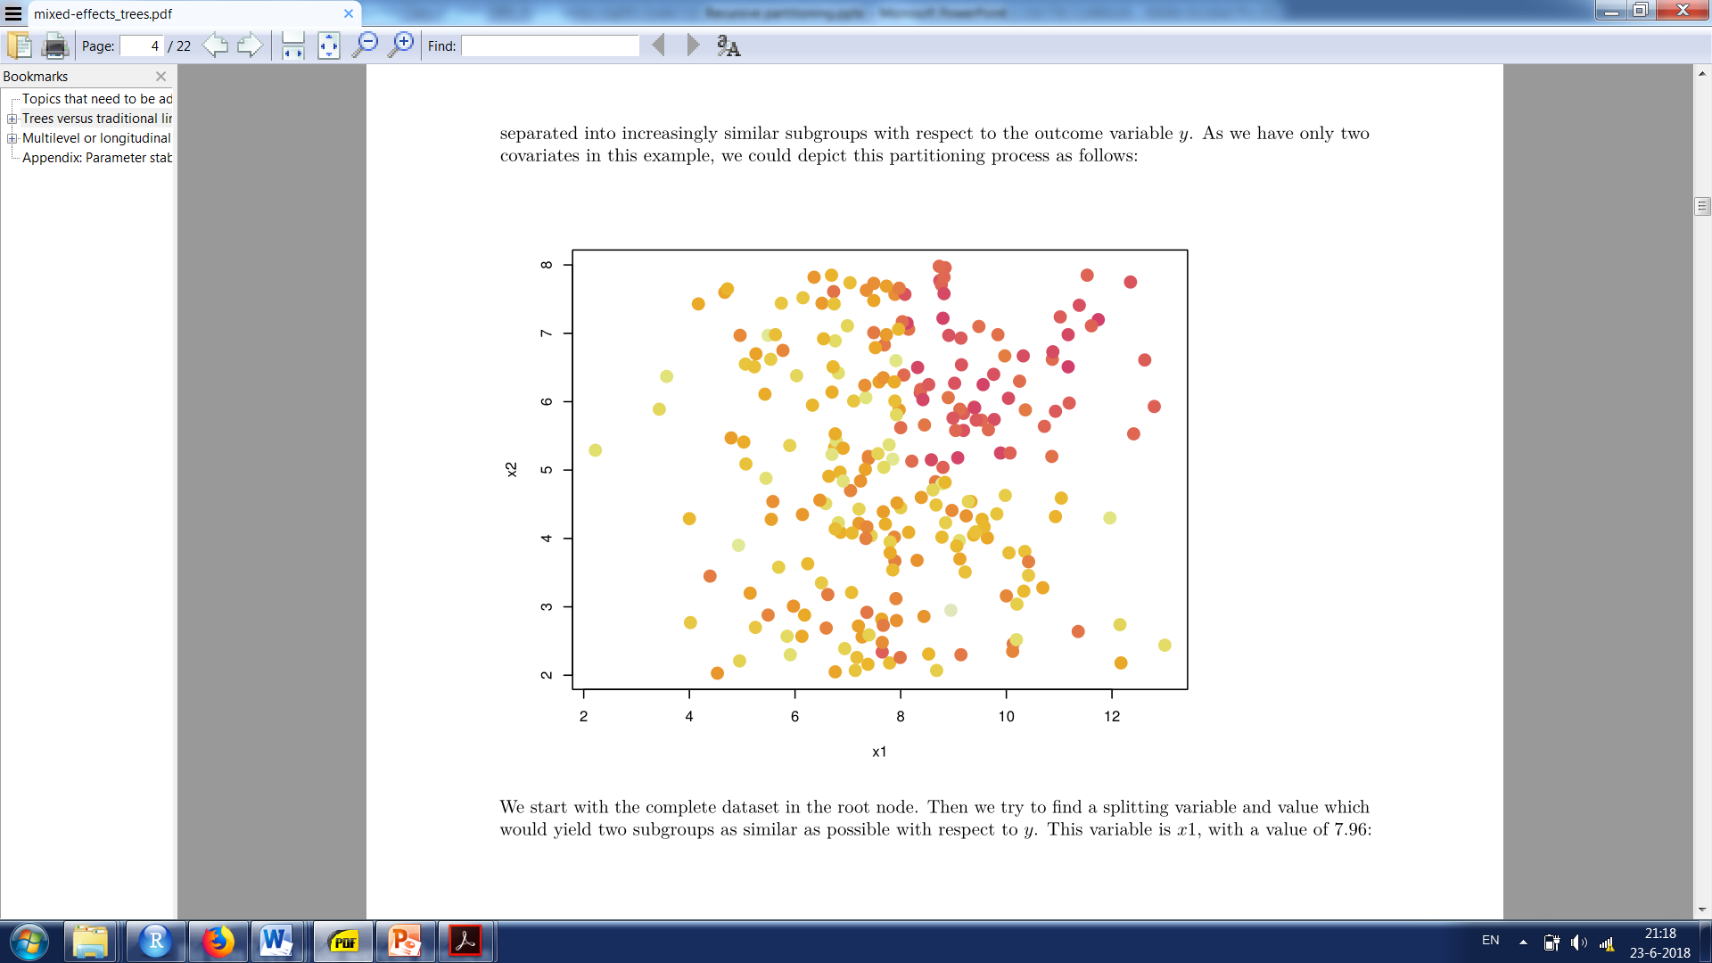
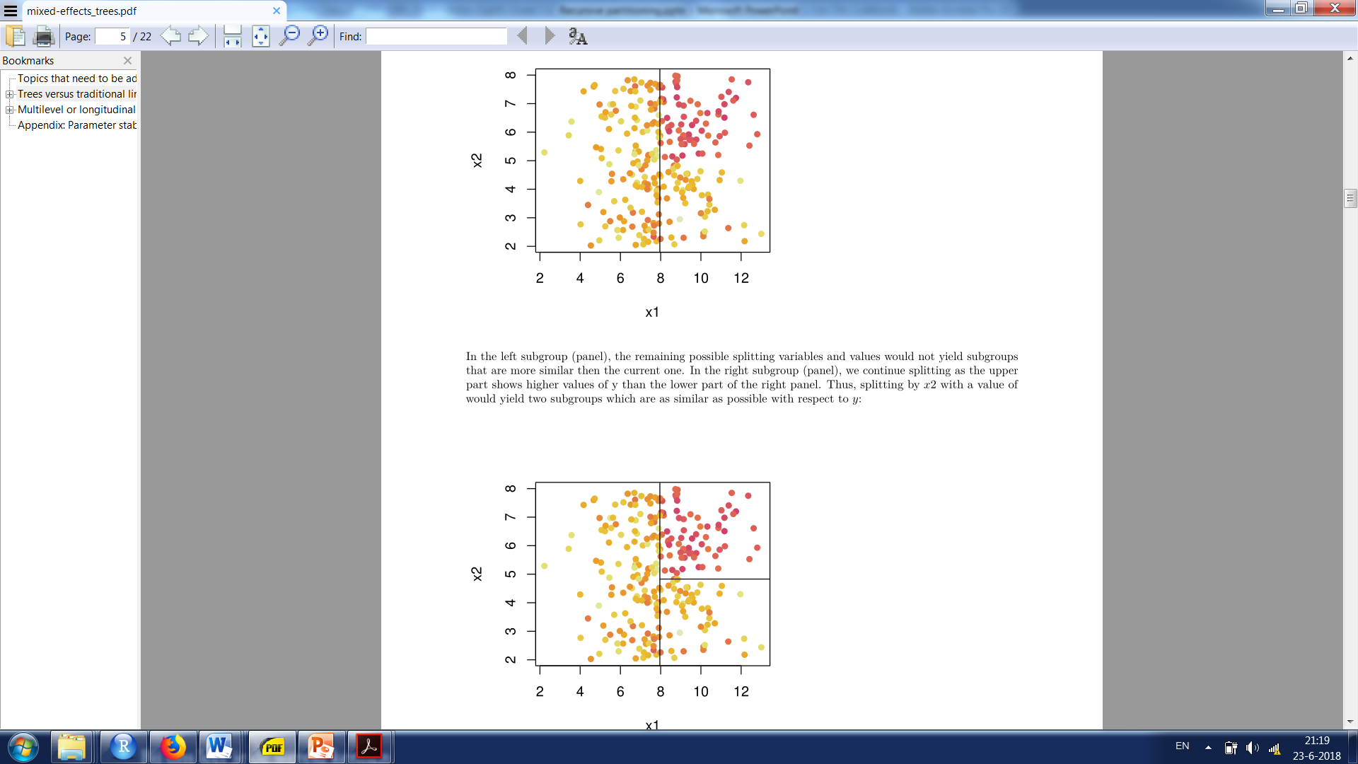

Slide 10
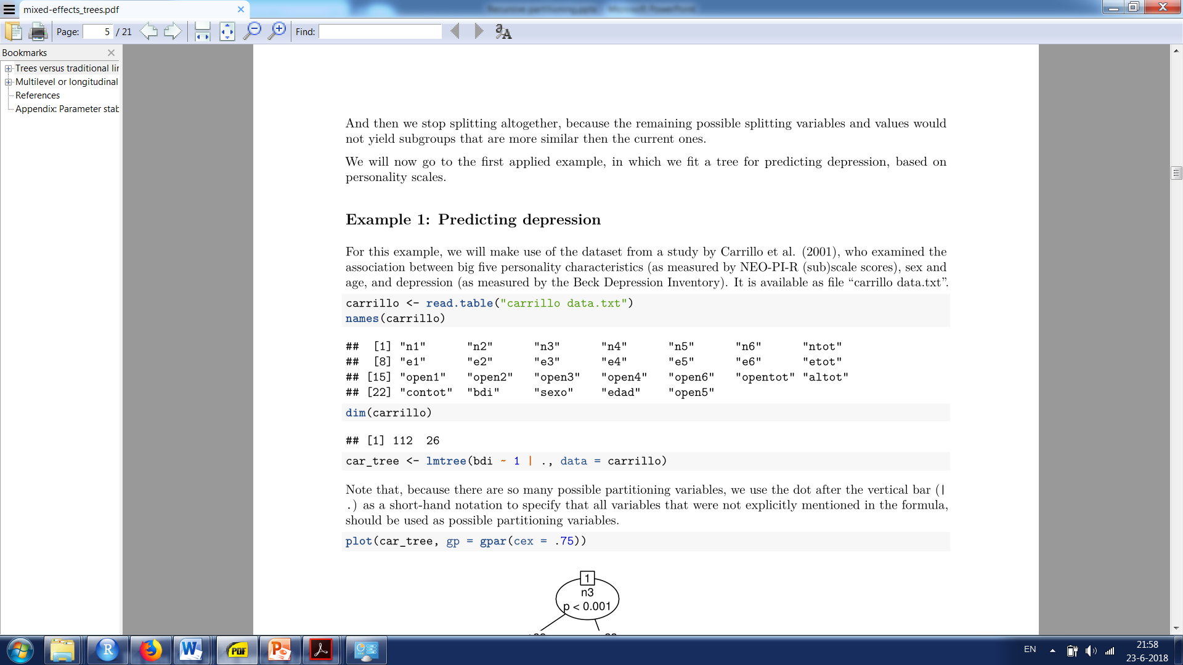
Example 1: Predicting depression with personality scales

Slide 11
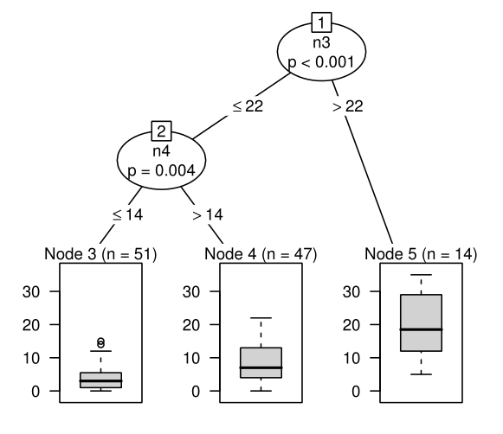

Slide 12
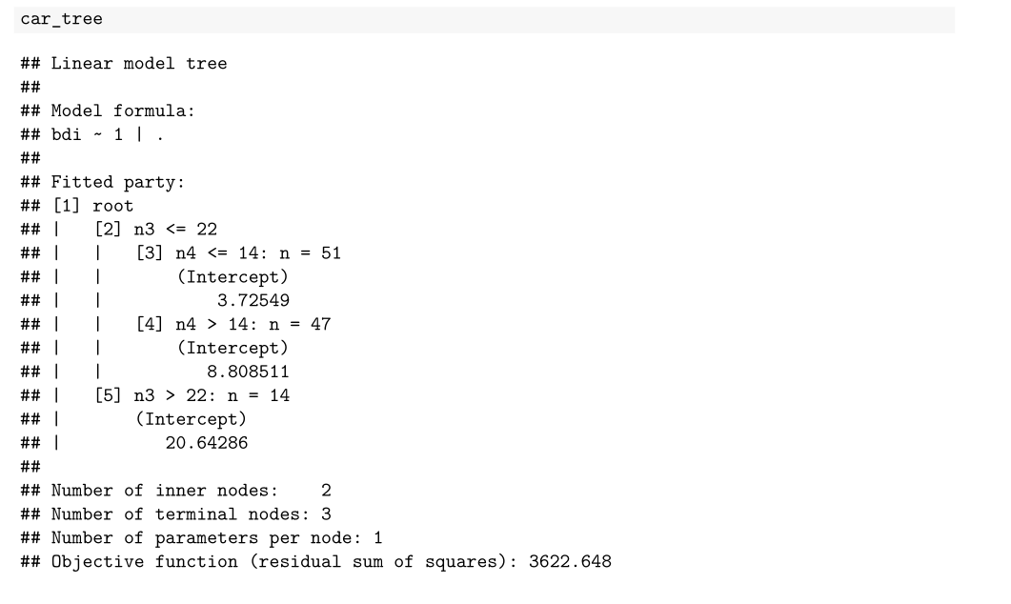

Slide 13
‘Fixed-effects’ sampling structure
Population
…
Level 1 sampling units

Slide 14
Multilevel or longitudinal data
Population
…
Level 2 sampling units
…
Level 1 sampling units
…
…

Slide 15
Multilevel or longitudinal data
Usual mixed-effects model: y = Xβ + Zb + ε
Fixed-effects (population level) part Xβ
Random-effects (cluster-specific) part Zb
Mixed-effects model trees (Fokkema et al., in press):
Fixed-effects part Xβ is replaced by a tree
Random effects b estimated as usual (globally)

Slide 16


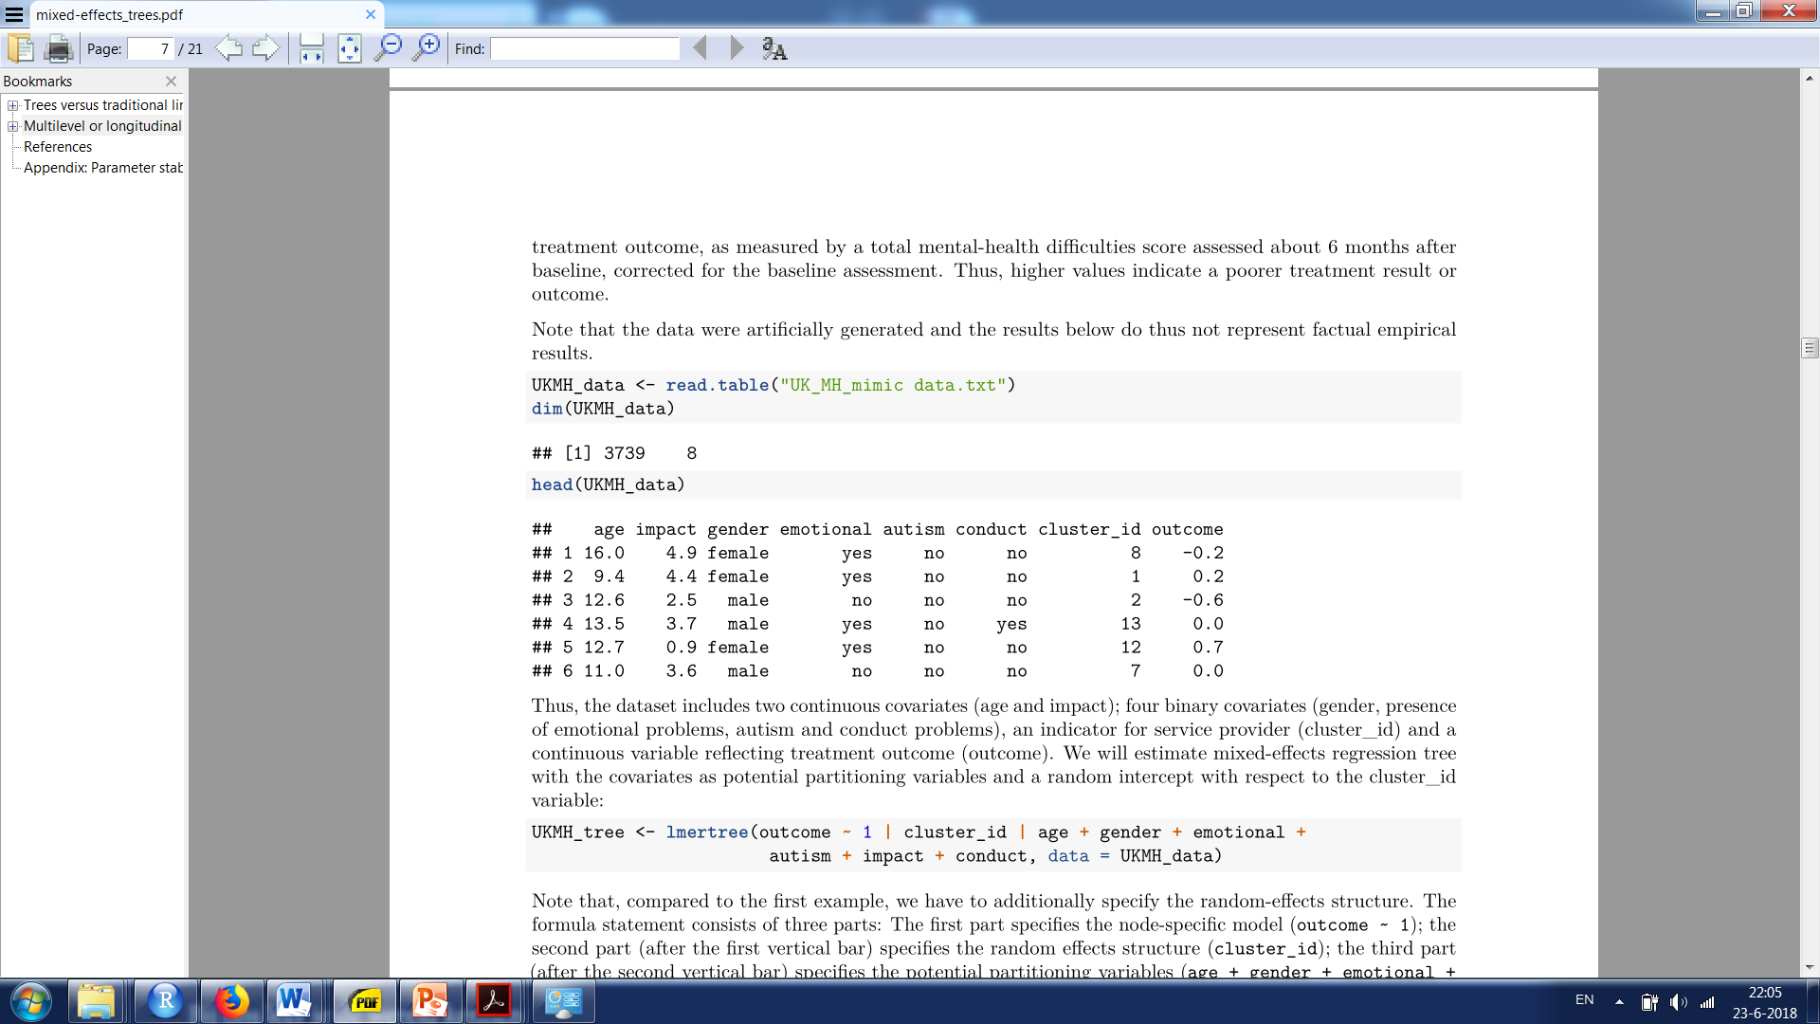

Slide 17
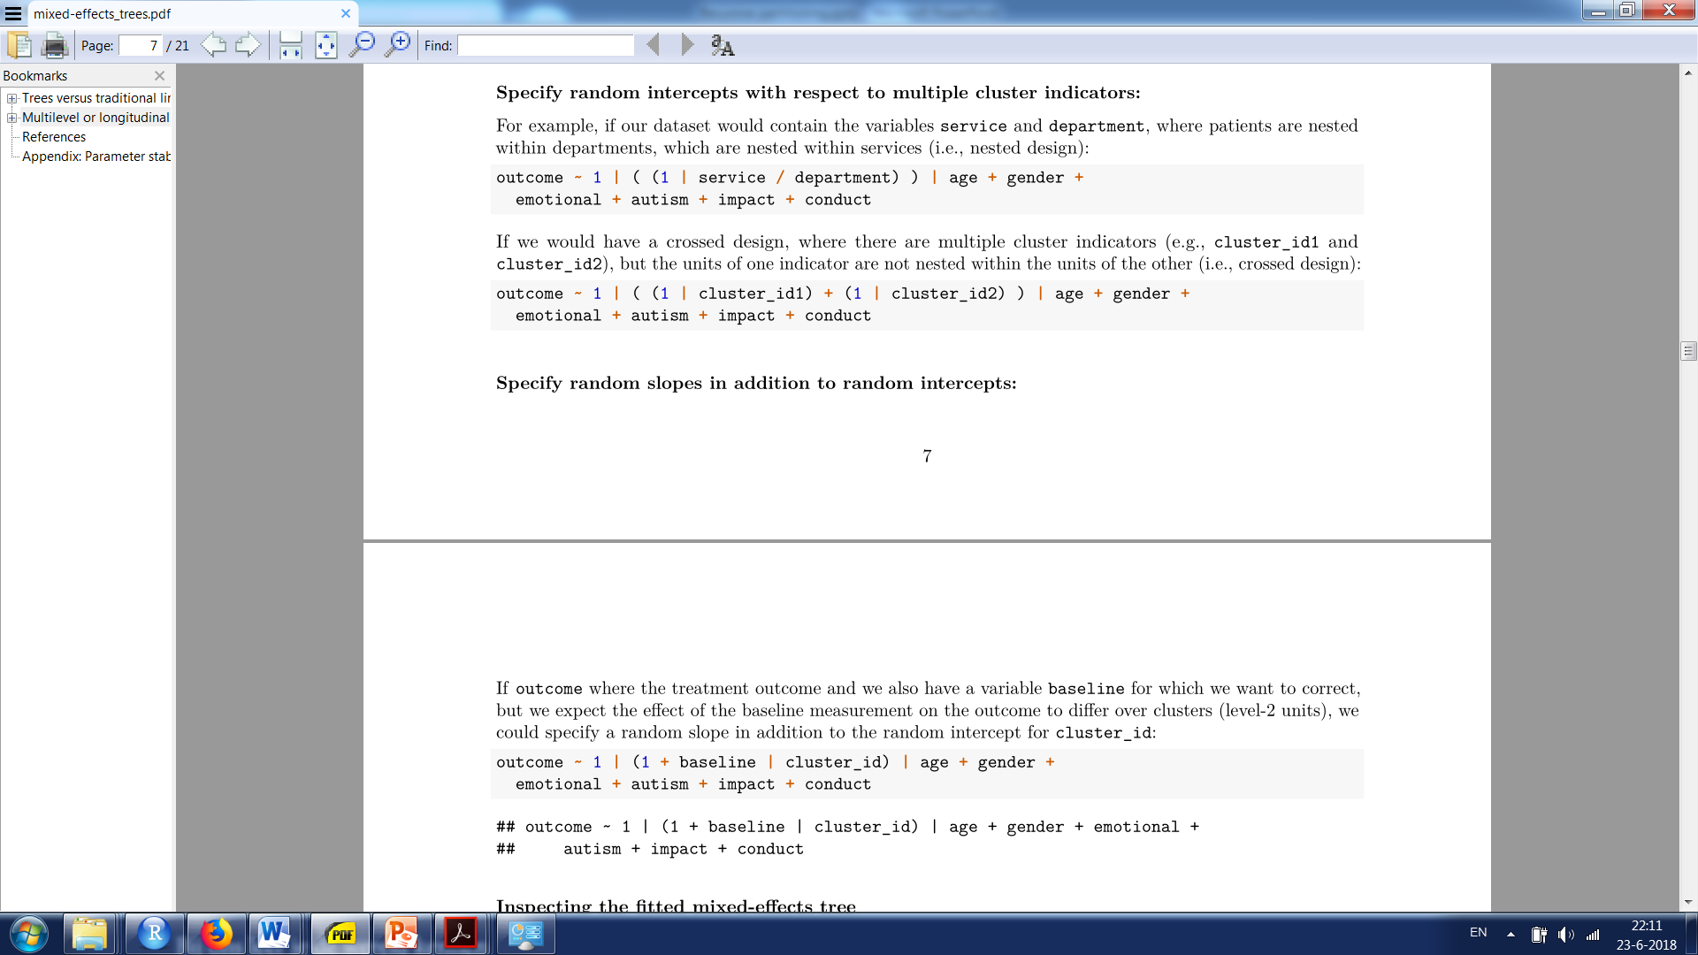
Specifying more complex random-effects structures
E.g., nested cluster indicators:
E.g., crossed cluster indicators:
E.g., random slopes (in addition to random intercepts):

Slide 18
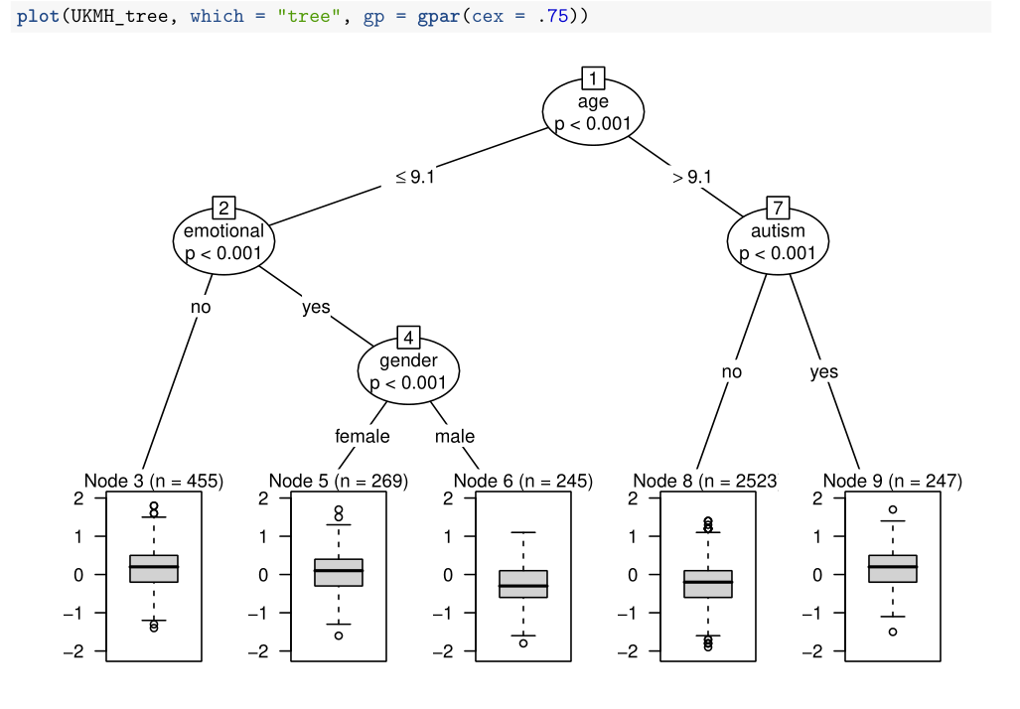

Slide 19
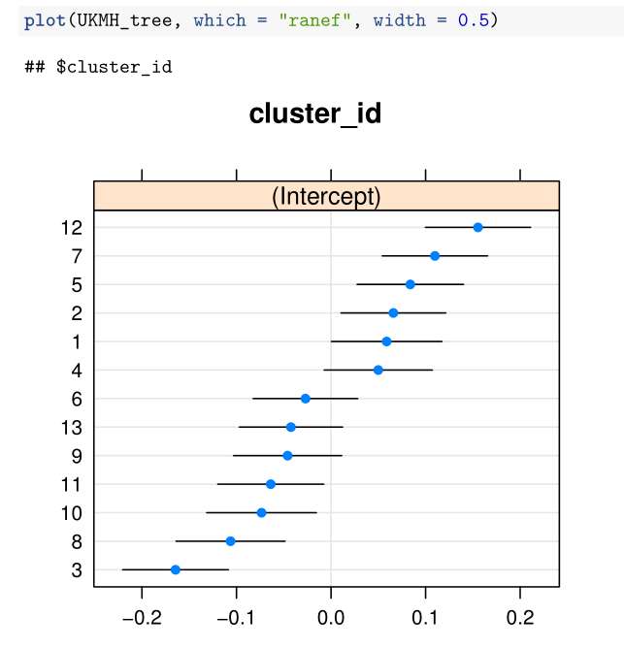

Slide 20
Checking (mis-)specification
Estimation of random effects introduces assumptions about the data distribution and thereby possibilities for misspecification
Misspecification may be difficult to detect, but plotting and inspecting the data can be of great help:
Plotting the tree and random effects already provides a check on (mis-)specification of the model
E.g, node-specific means and variances, outliers?
Residuals should also be checked, e.g., for possible heteroscedasticity

Slide 21
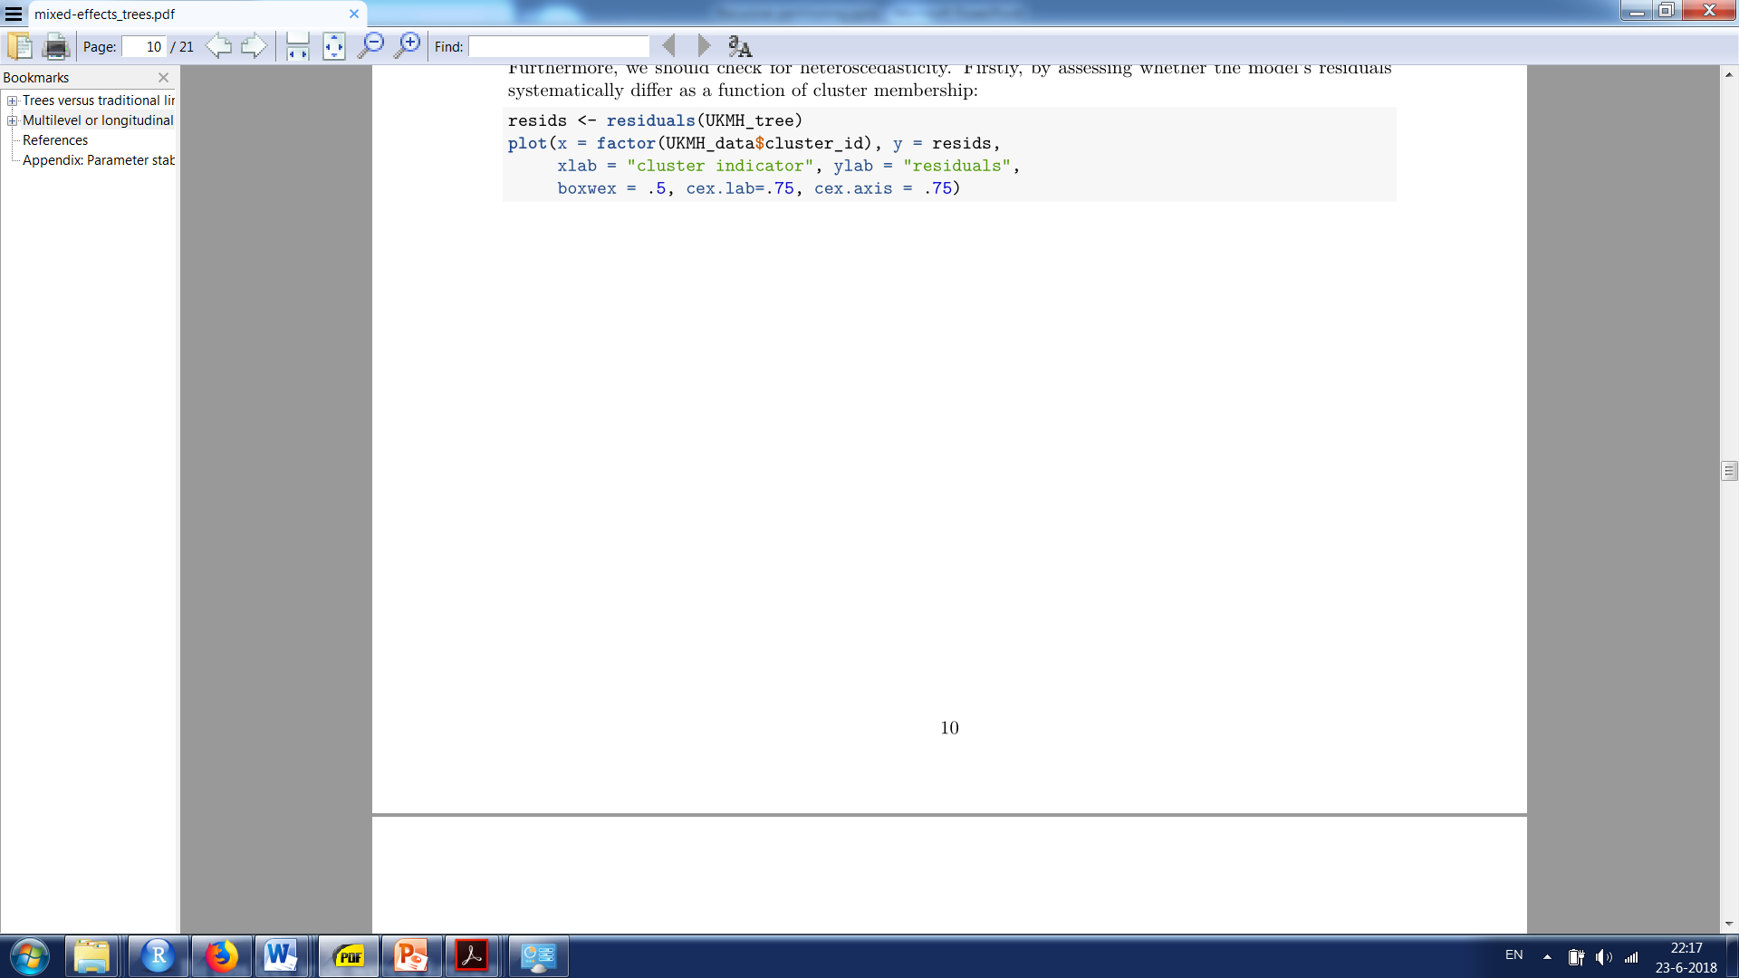
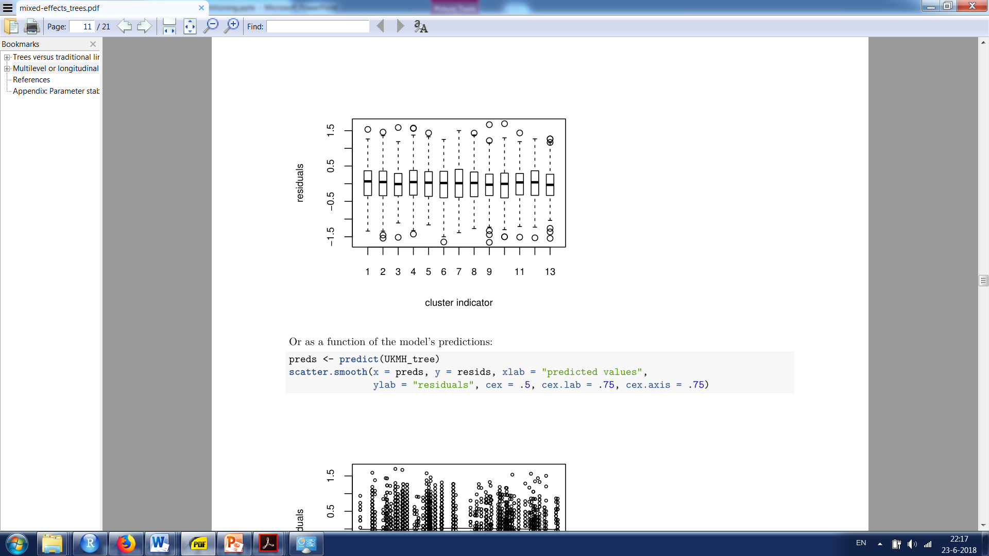

Slide 22
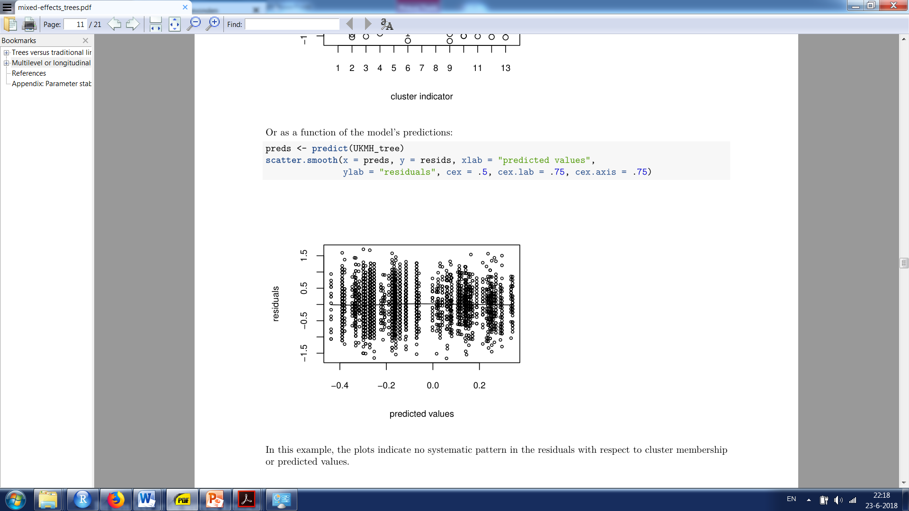

Slide 23
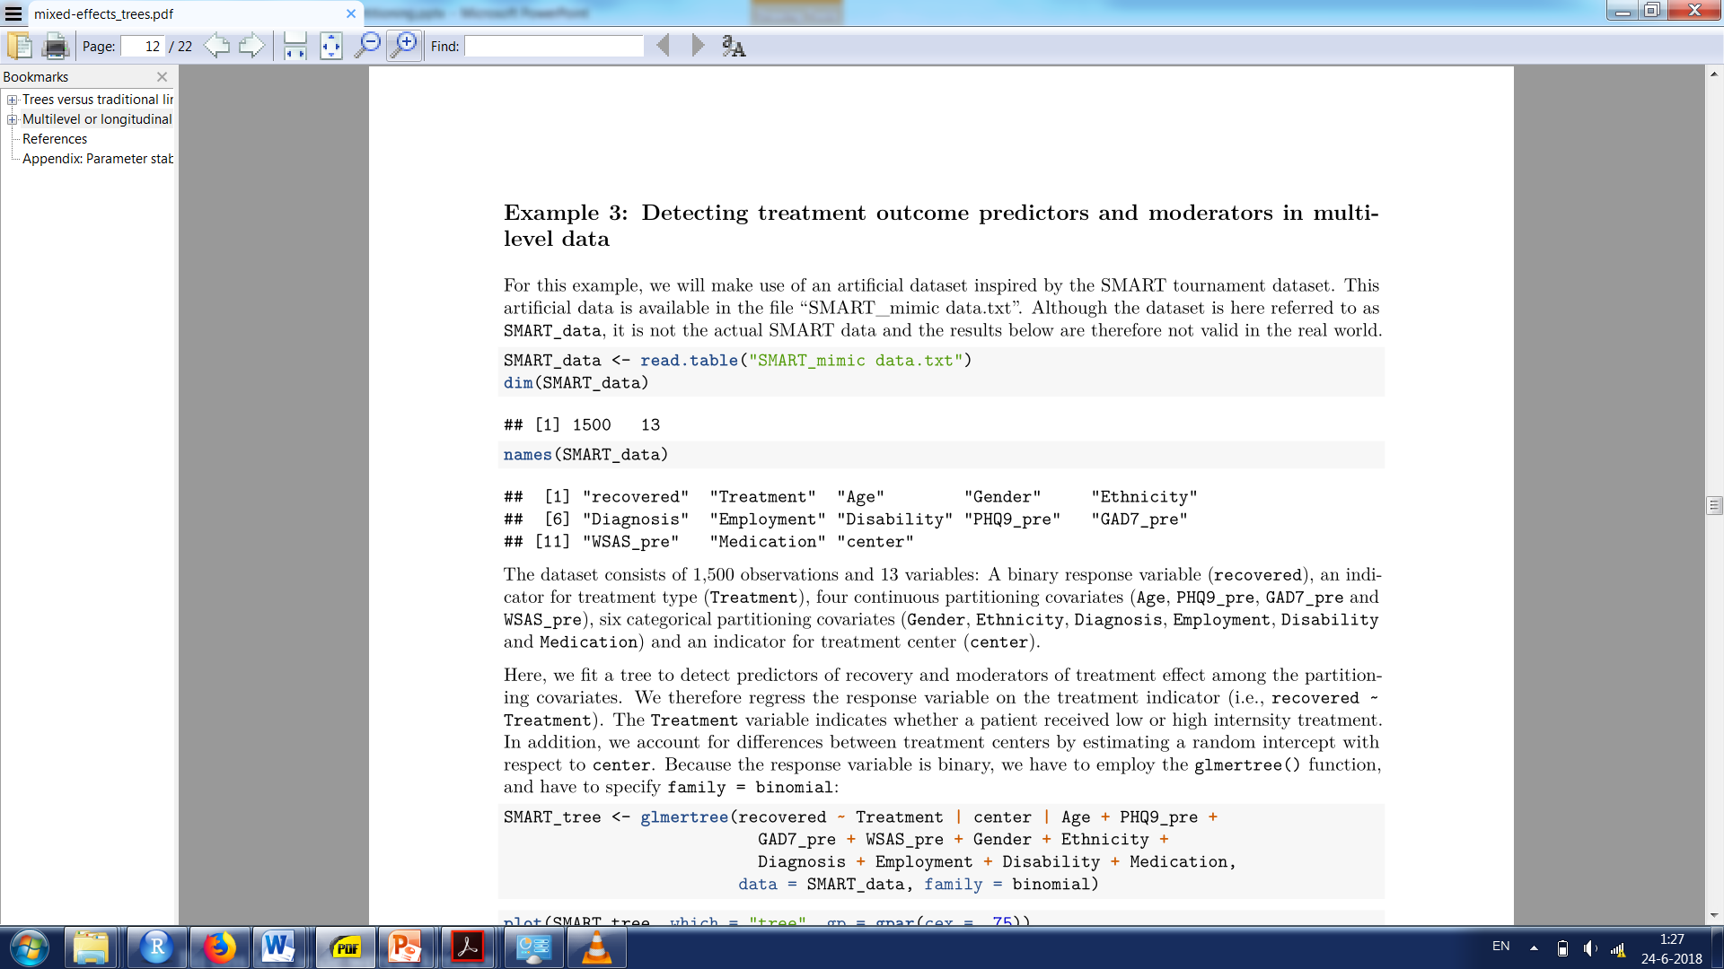
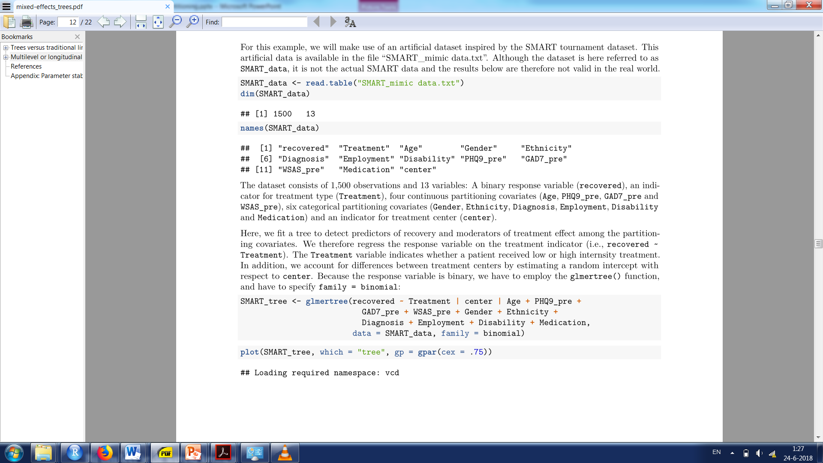
Detecting treatment outcome moderators and predictors in multilevel data

Slide 24
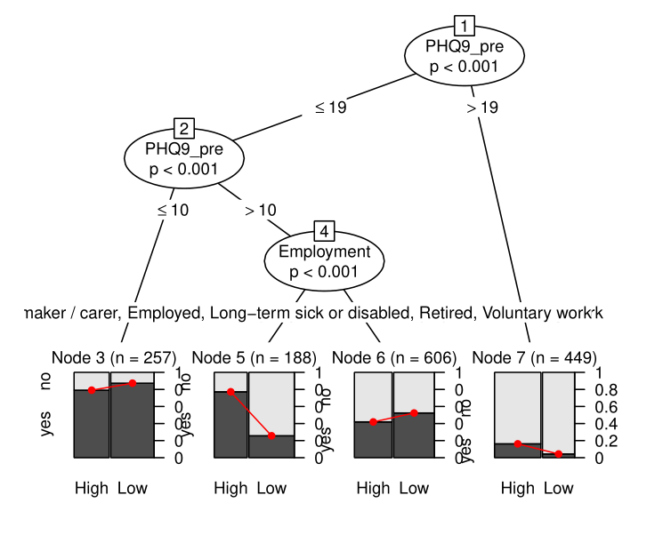

Slide 25
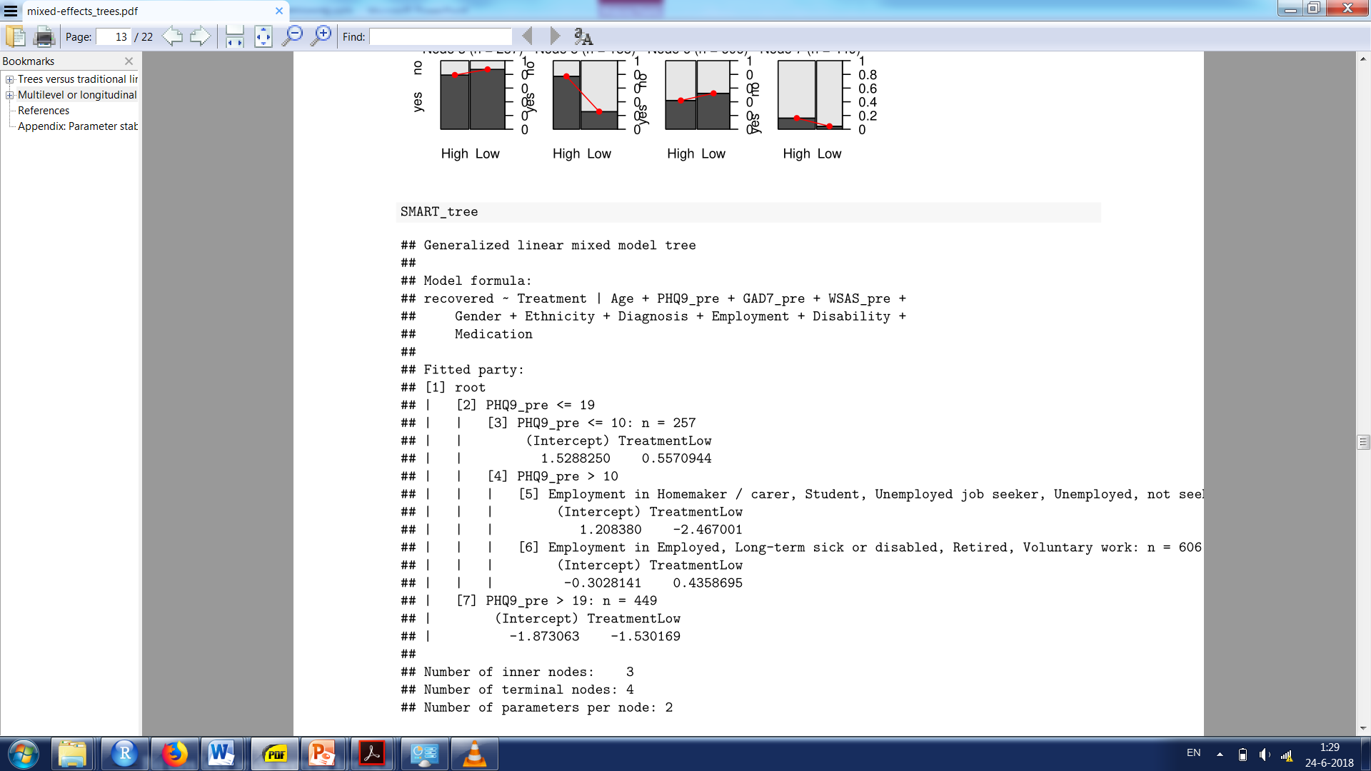

Slide 26
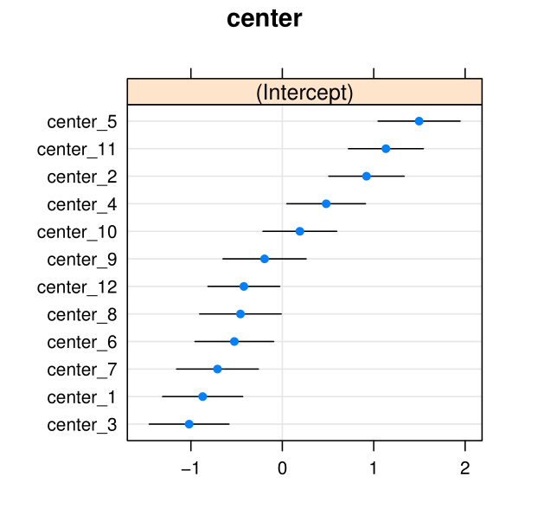

Slide 27
Concluding remarks
Package glmertree offers quite some flexibility, you can adjust the model formula in many ways to suit your data and research question
Should covariate be in the node-specific model or a partitioning variable?
Node-specific model is the confirmatory part
E.g., in RCT data, treatment should definitely be included as a predictor in the node-specific model
Partitioning variables are the exploratory part
E.g., possible predictors or moderators of response variable
Current and future developments:
Methods for cluster-level partitioning variables
By default, partitioning variables assumed to be on lowest unit-level
Yields too high Type II error for cluster-level variables, for which ‘cluster’ argument should be employed (implemented in development version on R-Forge)
Partitioning growth curve models

